Slide 1
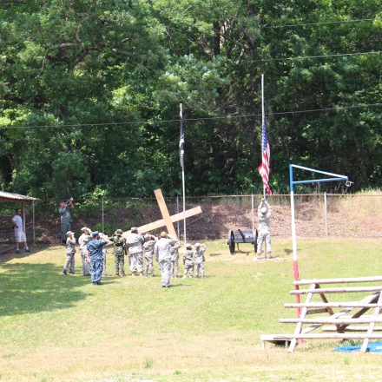
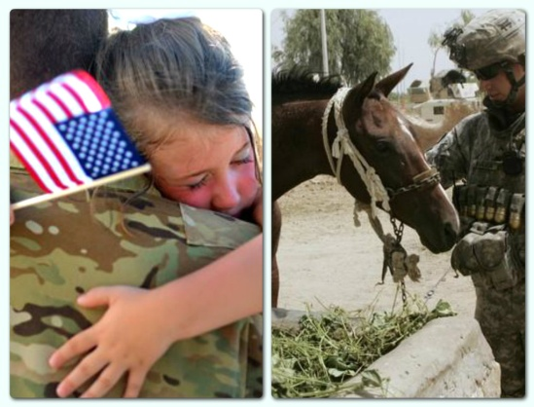
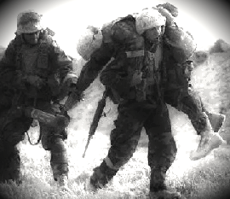
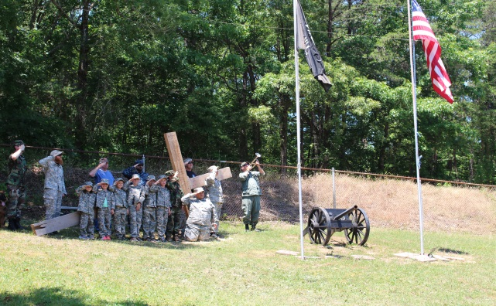

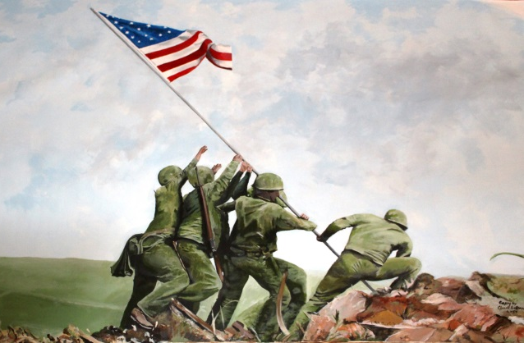

Visit The Fort!
Located between Calhoun and LaFayette, Georgia in the scenic and historic community of Villanow on Hwy 136.
Fort Villanow Veterans Project
A Safe Haven For Veterans
We erected a Cross in Memory of those who have taken their own lives after they returned home suffering from PTSD. Names are engraved by volunteer veterans.
Stigma, stereotypes and lack of resources cannot continue to be reasons for not receiving
help for PTSD.
At Fort Villanow, we want to open the door for more veterans in need of help. We also want to provide a place for kids to come and have fun while learning more about the important role that veterans have played in the lives of every American while inspiring a love of The United States of America !
Welcome
Veterans of All U.S. Military Branches.
Fort Villanow is
a place where veterans
can feel at home and
talk about their
experiences with others
who have been there….and care !
Est. in 2014
Our Museum honors our military with artwork & memorabilia of U.S. history and Meeting Hall for meals, events, movies and guest speakers.
Fort Villanow Veterans Project, located at
12650 East Hwy 136
La Fayette, Georgia 30728 (in Villanow)
Office: 706-397-8860 Cell: 706-639-7007
Evenings Veteran #: 706-397-2116
www.fortvillanow.com ftvillanow@gmail.com

Slide 2
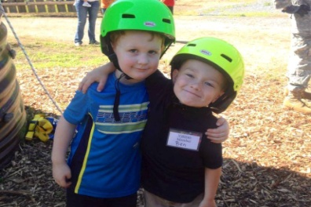
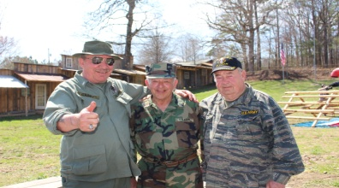

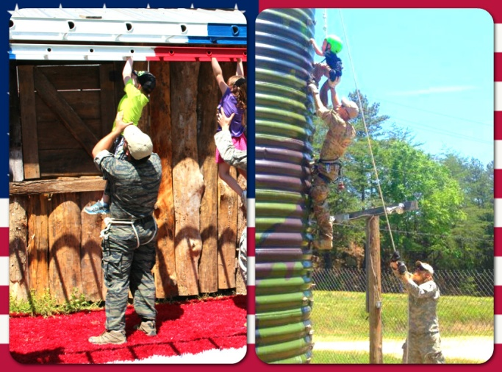
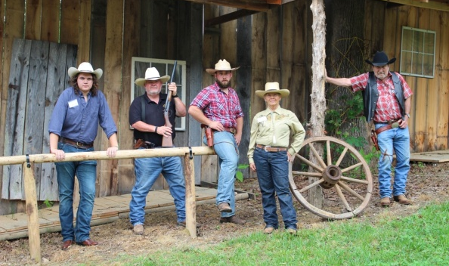
Veterans helping Veterans by providing a place to meet & re-adjust and offering opportunities to learn new skills & hobbies like:
Veteran participation is key to the success of the For !!.
If you would like to be involved, log on to our website and click on the
“For Veterans” tab or call us directly or just stop by and visit !!
There is no corporate sponsorship or government funding at Fort Villanow.
We are a group of local veterans, all pitching in to make a place where we feel comfortable to talk and be together.
Everything here has come from donations and we all share the burden of paying for the continued operation of the fort.
No corporate salaries or expensive
ad campaigns here.
100% of donations and income goes directly to help Veterans & the Fort.
Blacksmith & wood shop
Fishing/Camping/Hiking
Trap Shooting, Quail Hunt
Victory Garden as therapy
Scuba diving & snorkeling lessons for wounded warriors
Horse Handling, Wagon Rides, Western Events
Survival and Self Defense Classes
Tower Climbing and Repelling
Kids Survival Camp & obstacle course
Military Bus for outings, wheelchair accessible
Marches to D.C. for Veterans Benefits currently for Free Hunting & Fishing License anywhere in the U.S.
Free hot meals for Veterans on Military Holidays.
Christmas for kids & fireworks on the 4th
Something remarkable is happening in scenic Villanow, Georgia.
A unique place for all kids and for those who served our country is now here with the help of local businesses, local veterans and people like you. Look at the fun we are having !
Fort Villanow Veterans Project was created by local Veterans, for Veterans & all Families to enjoy…
Our goal is to give Veterans and their families a haven of hope. We want to offer a place without judgement for veterans. The appeal of a fort out of the old west and modern military type activities and horses have a therapeutic benefit. The joyful sounds of children is a reminder that better days are possible.
Your materials & financial contributions are tax deductible through our sponsoring 501(c)3 partner. NEHRF. KEEP IT LOCAL when giving to charitable organizations & see where your money goes!
Veterans… Please share this with others who are searching for something new and fun to help them though tough times.
We have members from WWII, Korea, Vietnam, Afghanistan and
most recent battles.
$1.00 per person annual membership fee is required to enter
$25.00 per Military Person annual membership fee is asked for to participate. You receive an ID Card allowing 10% discount at many local business’s.

